Slide 1
ECTE250 Project
Group b

Slide 2
Introduction
Good morning everyone today we will display a possible project that our team will deliver with the central focus of helping the environment.
Issues with the environment are ever apparent and if we would like to have a world for our children’s children to exist in then we must take the necessary steps from now
The best course of action is to find ways to better our energy use, either through kinetic energy storage or through just better/more optimal use in general

Slide 3
What is a Piezoelectric System
Piezoelectricity is the electric charge that accumulates in certain solid materials (such as crystals, certain ceramics, and biological matter such as bone, DNA and various proteins) in response to applied mechanical stress. The word piezoelectricity means electricity resulting from pressure and latent heat.
-Wikipedia

Slide 4
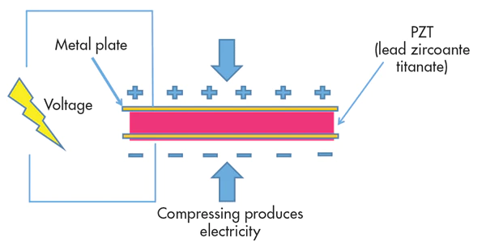

Slide 5
Piezoelectric System
Within the scheme of using a piezoelectric system two possibilities come to mind. The first is a rumble strip set up and the best use case that comes to mind would have to be at the Dubai Mall entrances. That should give the system a huge opportunity to gain and store energy, through which this stored energy can be used to possibly power signs and what not.
The second scheme would be the same system but not car related. In this case we consider placing the system by the Dubai Mall fountain show where a lot of people walk, this should also activate the system and allow it to charge.

Slide 6
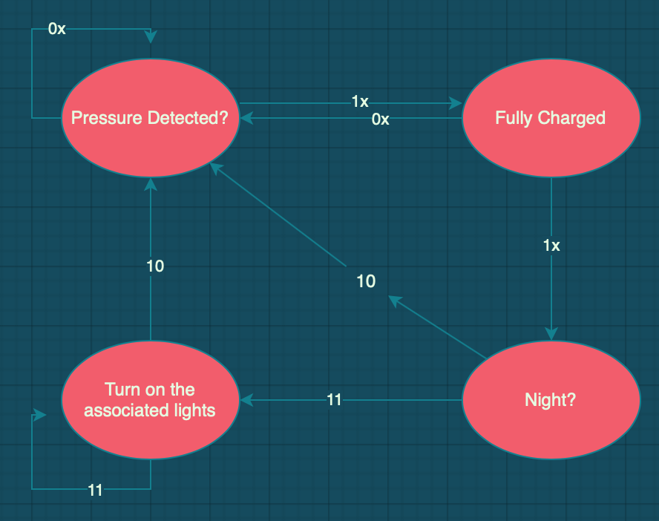
Possible State Diagram for the Piezoelectric System

Slide 7
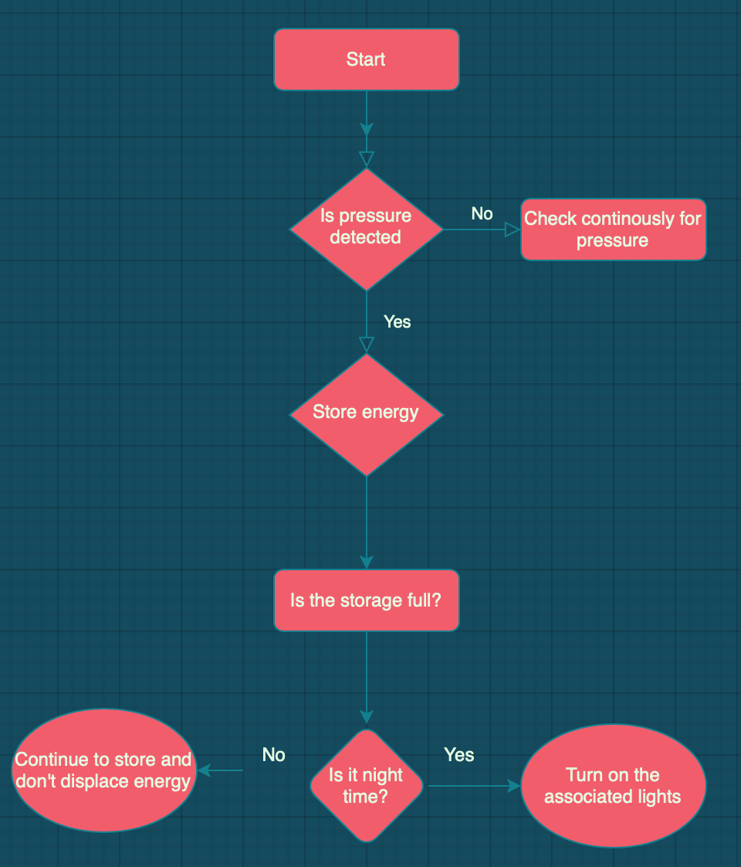
Flow Diagram
The main idea is for the system to run independently with two sensors, a pressure sensor and a light sensor. Once the conditions have been met, which are that it is night time, and that the sufficient energy has been stored then the energy should be displaced to the associated light fixtures deemed appropriate.

Slide 8
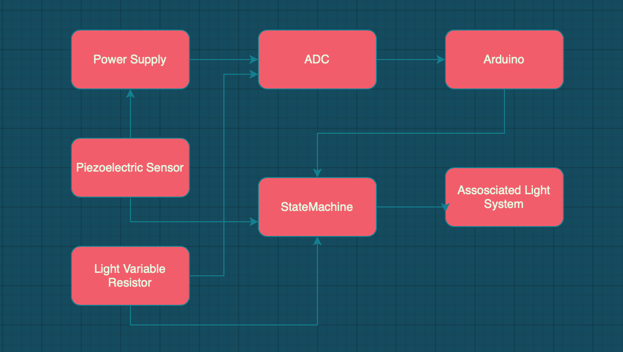
Block Diagram

Slide 9
Reasoning behind this decision
It is my firm belief that this technology has a lot of potential to be extremely vital in the future and it’s applications from a brainstorming standpoint seemed limitless as kinetic energy is such an accessible resource.
The potential to charge our phones while we move, the potential to charge electric cars wirelessly as they’re driving is a possibility as well
The best feature about this, is the fact that it uses natural forms of energy thus providing great value in our steps towards a greener future

Slide 10
Who could benefit?
Variety of companies could benefit from this technology (Globally speaking)
This technology has infinite applications from Emmar to Damac to RTA. The applications truly are endless and it stands to be said that once implemented the values will be reaped accordingly.
Especially when you really focus on the “Green Energy” aspect of it all, that is a theme that we as the people of earth are collectively striving towards

Slide 11
Estimated Labor Costs
Deliverable | Hours | Cost
1 | 5 | 1500
2 | 10 | 3000
3 | 4 | 1200
4 | 6 | 1800
5 | 20 | 6000
6 | 25 | 7500
7 | 2 | 600
8 | 2 | 600
Total: | 74 | 22200 AED

Slide 12
Estimation of Cost
Component | Quantity | Cost
Resistors |  | 600 AED
LED Lights
Servo Motor
Ceramic Piezoelectric Sensor |  | 50
Light Variable Resistor |  | 10
Dual D Type Flip Flops |  | 4
Quad 2 input NOR Gate |  | 4
Quad 2 input AND Gate |  | 8
HEX inverter Gate |  | 4
Total: |  | 680 AED

Slide 13
Summary
This technology though may be inefficient in its current form, through advances in research and development it could yield plenty for the renewable energy community
Any Questions?

